Slide 1

Title: Comparative Study of TUNER and SIREN Architectures
Presented by: Yanet Tesfaye
Under mentorship of Professors Tiago Novello & Lúiz Velho
Date: July 2025

Slide 2
GOAL :
Compare TUNER and SIREN in:
Architecture
Remaining
Open
Questions
Training approach
Initialization

Slide 3




Sinusoidal neural networks have gained traction as powerful implicit neural representations (INRs) to model low-dimensional signals such as images, audio, and 3D shapes.
MORE…
IMAGES
AUDIO
3D SHAPES
Traditional neural networks suffer from a spectral bias. Thus, Sinusoidal activation functions, overcome this limitation by inherently modeling signals with high-frequency content.
The initialization directly influences the network’s ability to represent the frequency spectrum of the signal, and poor initialization often leads to noisy or overfitted outputs. Both SIREN and TUNER attempt to address these challenges but with different approaches and theoretical underpinnings.
Challenges: initializing and training sinusoidal networks is difficult and often empirical.

Slide 4





____
Overview of SIREN Architecture
____
ACTIVATION FUNCTION
WEIGHT INITIALIZATION
Weight initialization heuristic scales weights by ω₀ (typically 30) to stabilize gradients.
Standard multilayer perceptron (MLP) with sine activation functions.
__
MAPPING
OBSERVED PROBLEM
Input layer maps inputs through sine functions with randomly chosen frequencies in a range.
Empirical initialization can lead to overfitting or noisy high-frequency artifacts.

Slide 5
The key innovation in SIREN is the initialization scheme that scales the weights of the first layer to avoid vanishing or exploding gradients.
Specifically, weights of the first layer are initialized uniformly in the range [-1/ω₀, 1/ω₀].
Despite these innovations, SIREN’s initialization remains empirical: the choice of ω₀ and weight ranges is somewhat heuristic and sensitive to the specific dataset and signal
Additionally, SIREN lacks explicit frequency control during training, causing the network to sometimes generate frequencies outside the Nyquist limit, leading to artifacts.

Slide 6
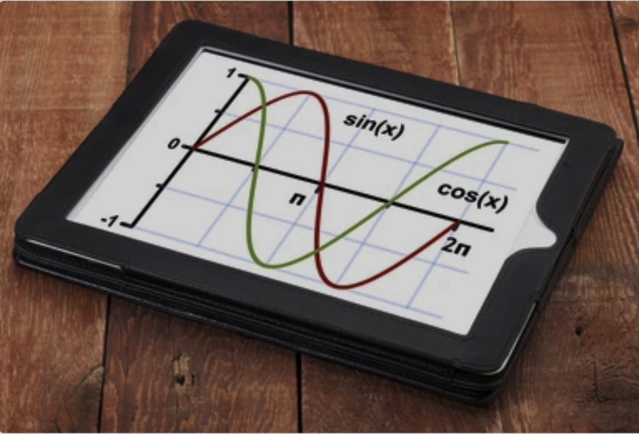



Overview of TUNER-Theoretical Foundation and Approach
TUNER builds on sinusoidal MLPs by applying Fourier series theory.
Theorem 1: Each hidden neuron expands into a sum of sinusoids with integer combinations of input frequencies.
Input frequencies are fixed integers, aligning with Fourier basis, and frozen during training.

Slide 7
TUNER (TUNing sinusoidal nEtwoRks) builds on sinusoidal MLPs by introducing a rigorous theory to explain how frequencies emerge through layer compositions.
Unlike SIREN’s random uniform initialization, TUNER fixes the input frequencies (freezing them during training) to guarantee that the network covers the desired frequency spectrum in a controlled way.
Moreover, TUNER introduces a band limit control mechanism based on bounding the hidden layer weights during training.
By clamping these weights, TUNER prevents the generation of spurious high frequencies beyond the Nyquist limit, thus reducing noise and overfitting.

Slide 8
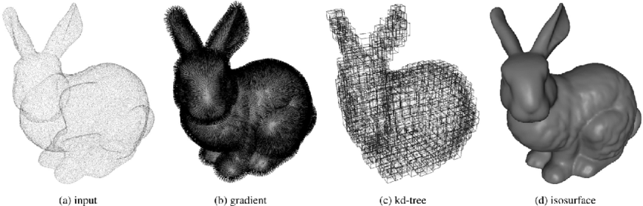




Detailed Architecture Differences
SIREN
TUNER
Standard MLP with sinusoidal activations applied at every layer.
Input frequencies are initialized as fixed integers aligned to the Fourier basis and frozen during training.
Input layer uses sine activations with frequencies randomly sampled from a uniform range.
Hidden weights are clamped to control amplitude of frequencies, enforcing band limit constraints
Weight initialization is empirical
and static — no frequency
control during training.
Training uses a new regularization term that keeps hidden weights small, preventing frequency explosion.
No explicit frequency bounding
— network frequencies can
drift during optimization.
The architecture uses trigonometric identities and Fourier analysis to inform its design and training.

Slide 9
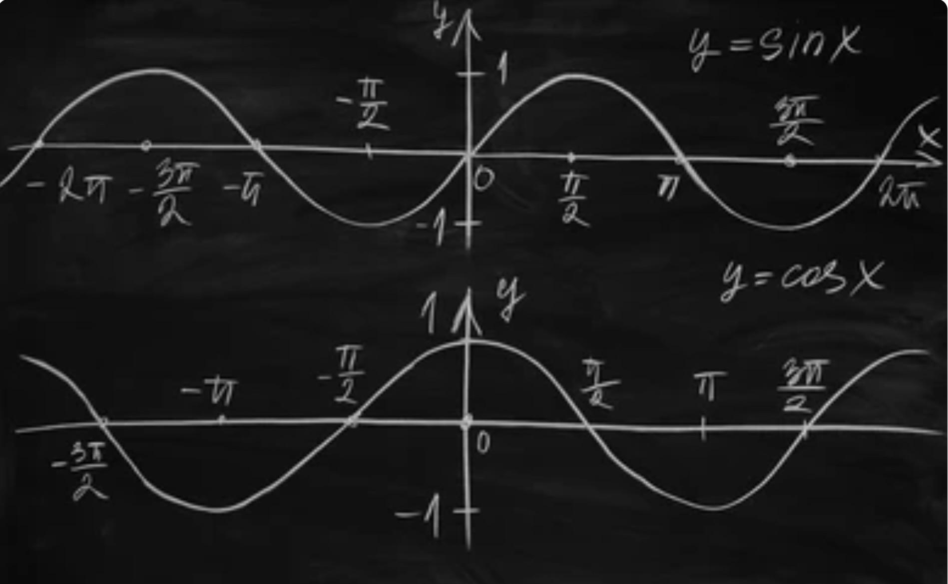





Initialization Comparison
Initialization is the cornerstone of effective sinusoidal networks.
SIREN Initialization
Chooses input frequencies uniformly at random from a fixed range of :
[−B, B]
Ignore some
important
frequencies
Wide range of frequencies
Undesirable high frequencies
Doesn’t guarantee
full coverage of
frequency

Slide 10

Initialization Comparison
Initialization is the cornerstone of effective sinusoidal networks.
TUNER Initialization
TUNER Initialization instead samples input frequencies as integer multiples in a limited band of:
Equivalent to sampling from a discrete Fourier basis
[−b, b]
Ensures complete spectral coverage
Splits the input frequencies into “low” and “high”
Input frequencies are kept in the low band to reduce overfitting.
frequency groups

Slide 11
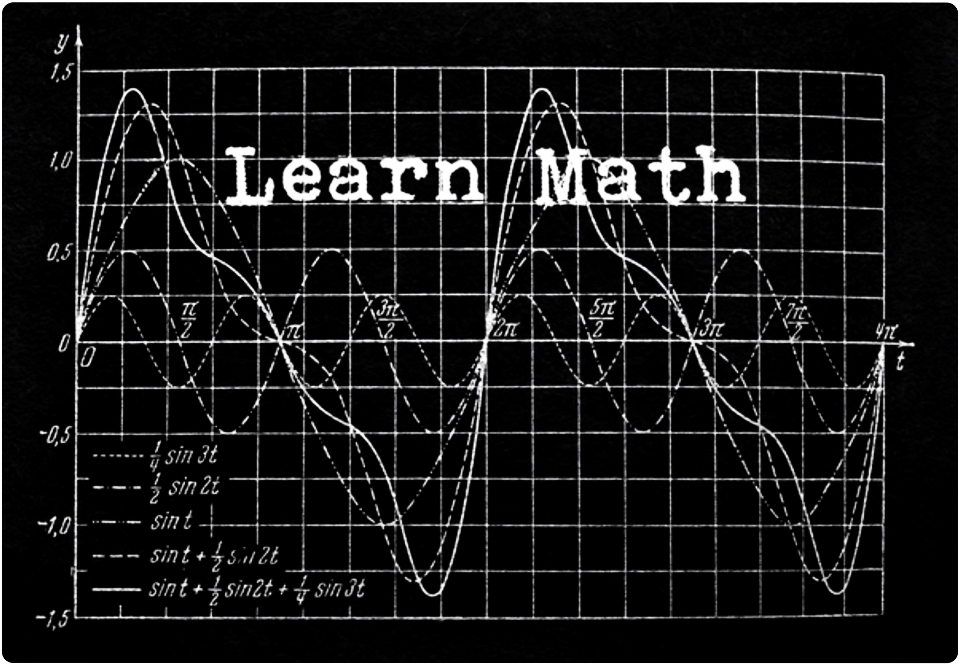

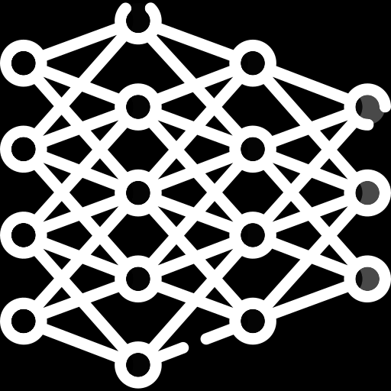




Training Differences and Bandlimit Control
Training in SIREN
Hidden weights can grow arbitrarily large, which increases the amplitude of high-frequency components, often beyond the Nyquist limit.
This uncontrolled growth causes ringing artifacts and noisy reconstructions, requiring early stopping

Slide 12
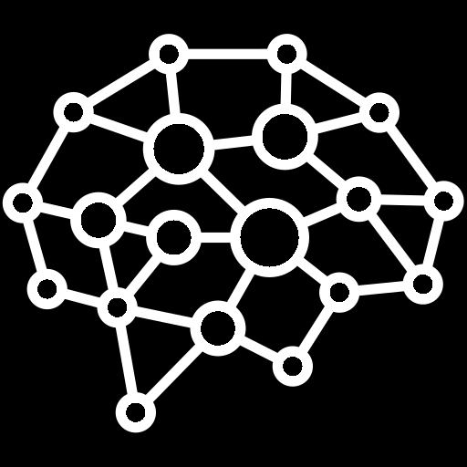

Training in TUNER
Employs a weight clamping mechanism where weights in the hidden layers are limited to a predefined range
This limits the amplitudes of higher frequency components generated by the network
Introduces a regularization term based on the upper bounds of amplitudes (derived from theory)

Slide 13


REGULARIZATION TERM :
Training thus balances fitting accuracy with frequency control, reducing overfitting and noisy artifacts.
Penalize large weight magnitudes

Slide 14


Potential Problems Both Methods Leave Unsolved
Scalability to High Dimensions
Shallow Architecture Only
Experiments focused on 3-layer MLPs.
Need for Task-Specific Tuning
Frequency Coverage Trade-off
(TUNER)

Slide 15
Summary and Final Remarks
SIREN introduced sinusoidal activations with heuristic initialization, enabling high-frequency modeling but with instability.
TUNER adds a theoretical framework grounded in Fourier series, with principled initialization and frequency bounding.
TUNER achieves more stable training, faster convergence, and cleaner reconstructions
However, both models leave room for further improvement in flexibility, scalability, and understanding of frequency learning dynamics.

Slide 16
THANK YOU FOR LISTENING AND FOR YOUR GUIDANCE !

